Slide 1
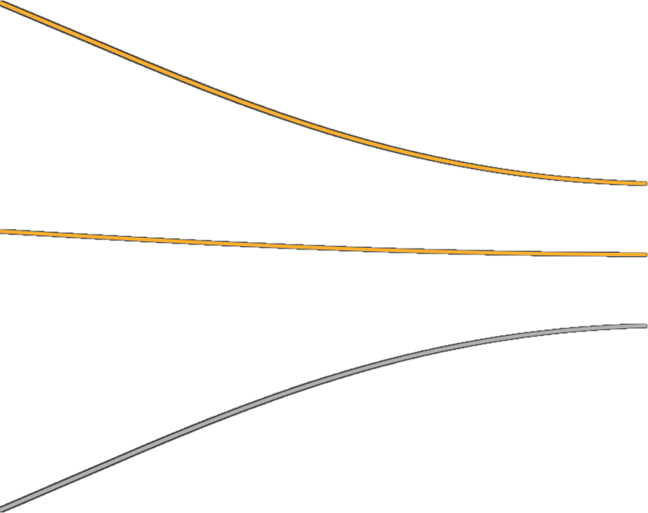
PROCEDURAL ART PRESENTATION
Ryan Stande 477316
Engineer

Slide 2
TABLE OF CONTENTS
Video & closer look in Unity
3. Customizability and Control
On the Look and Feel
My proudest accomplishment
Reference list
Details on my research
Meshes and structures

Slide 3

VIDEO & CLOSER LOOK IN UNITY
Procedural Art Presentation

Slide 4
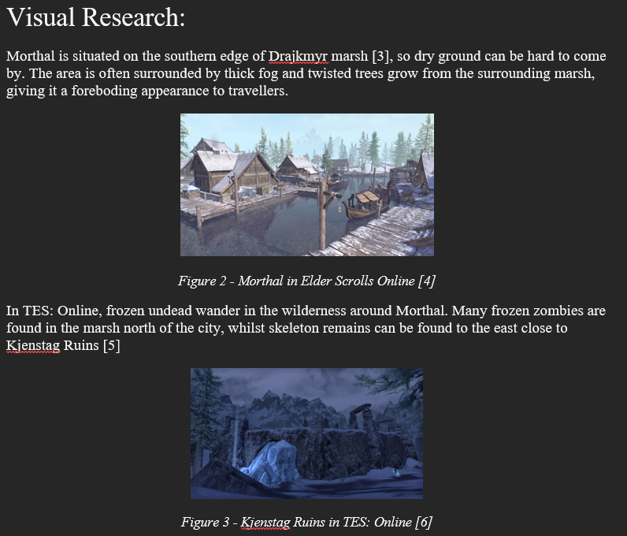
Research: Visual
Procedural Art Presentation
Notes:
Here you either show your research document and show us your approach, the methods you set out to use and other looks into interesting and suitable tools and techniques if applicable.
Use the rubrics from the manual as a basis for what you want us to see:
(use as many slides for this as you want or need)

Slide 5
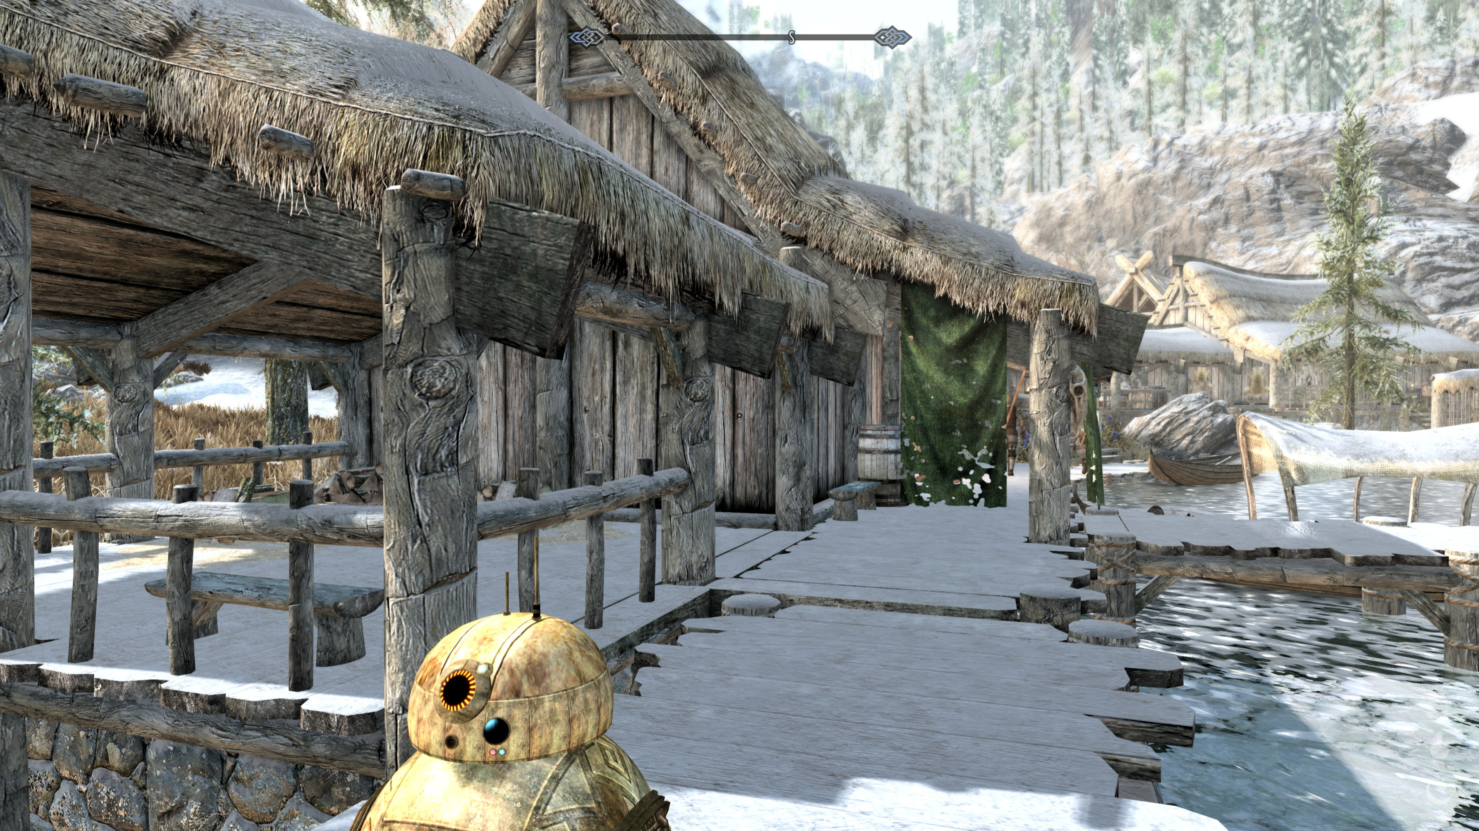
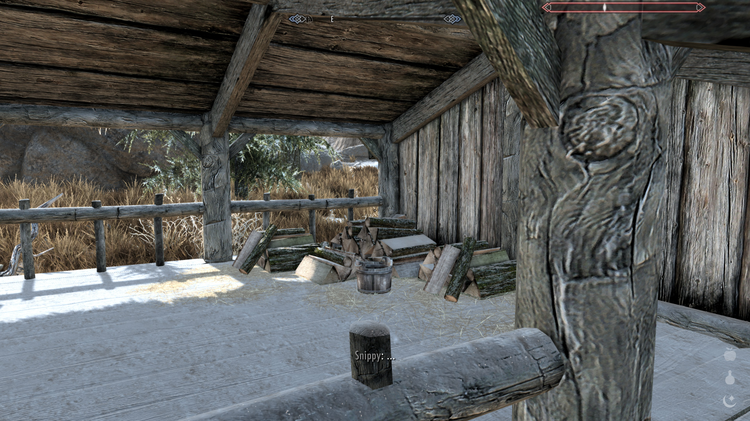
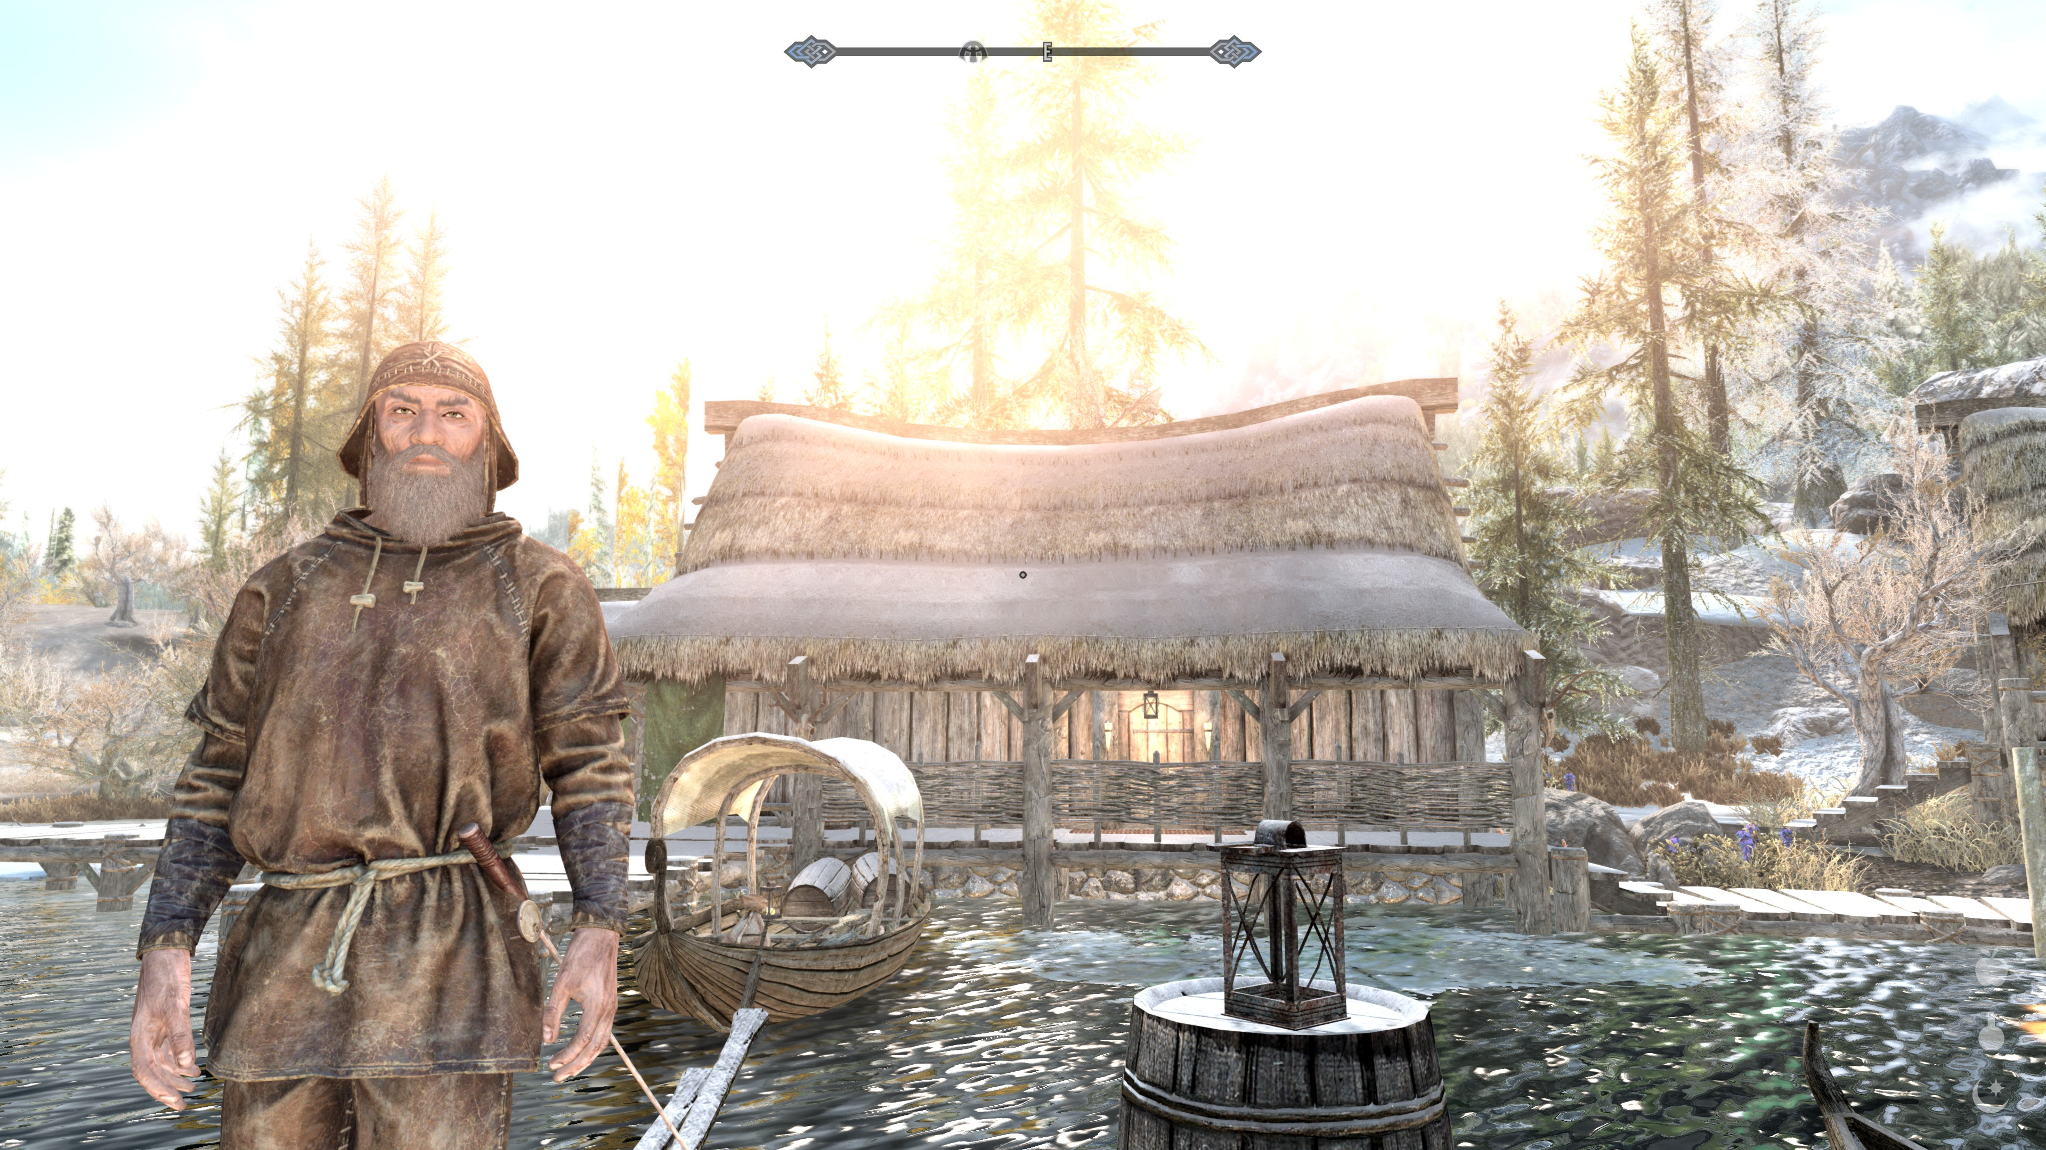
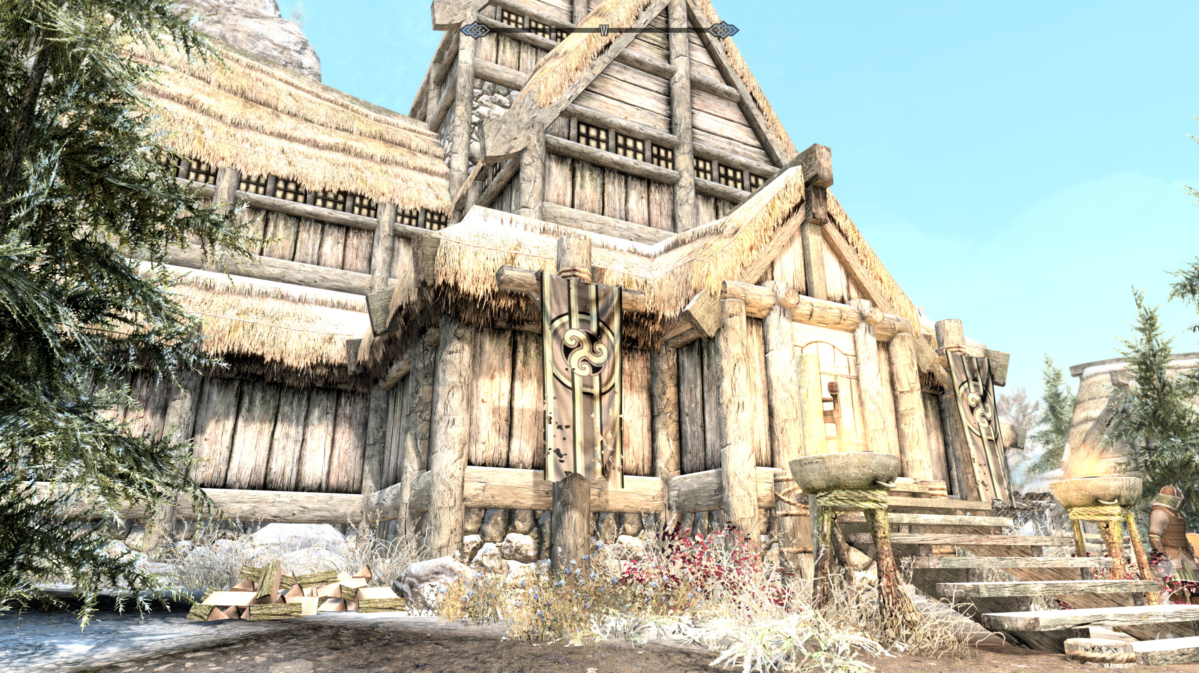
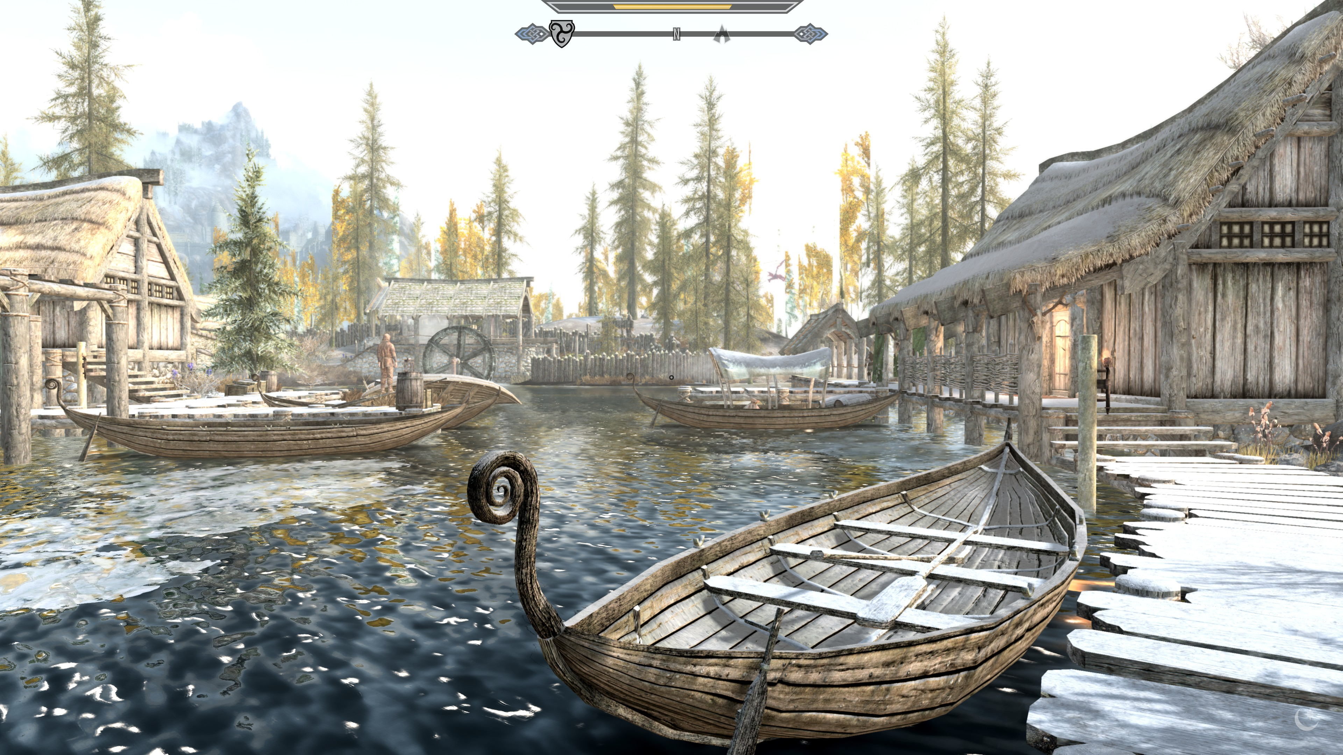
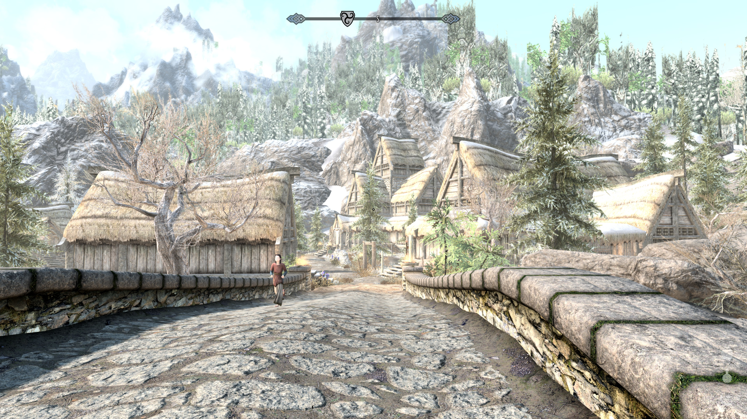
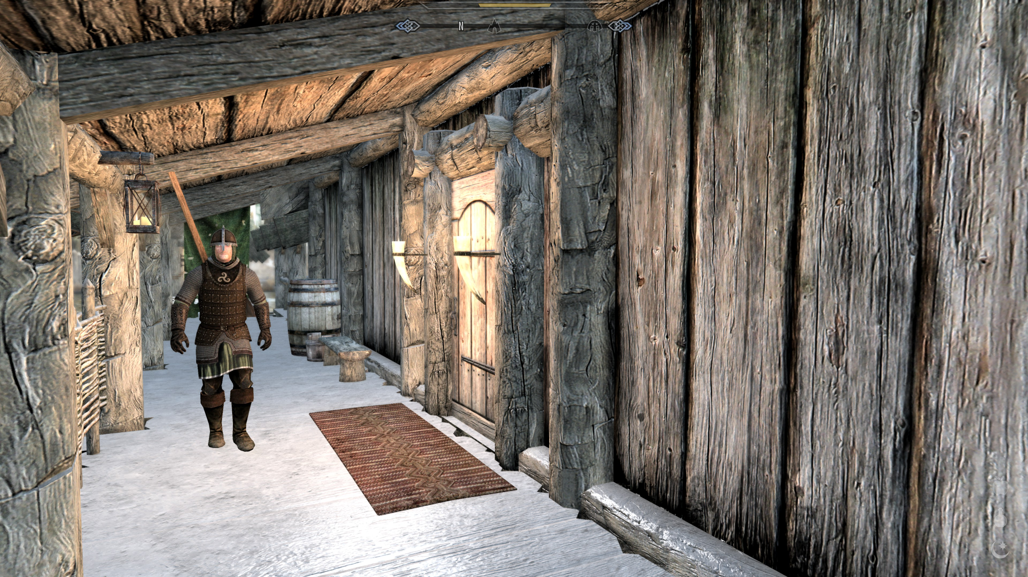
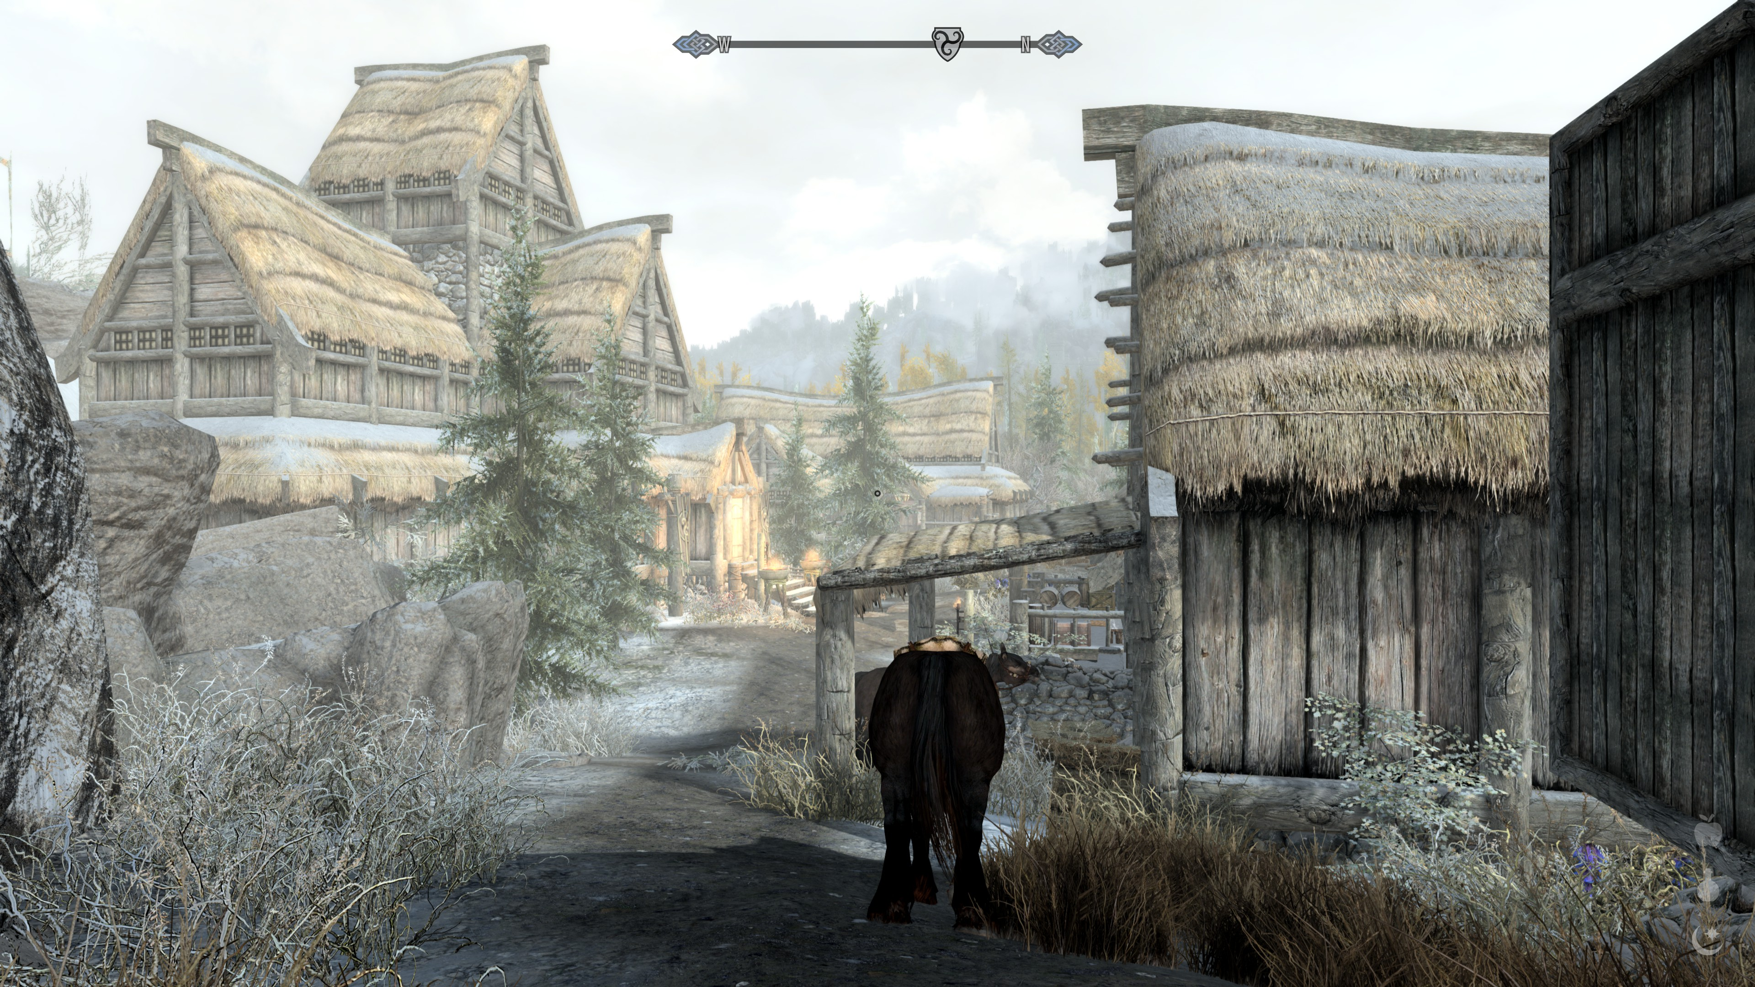
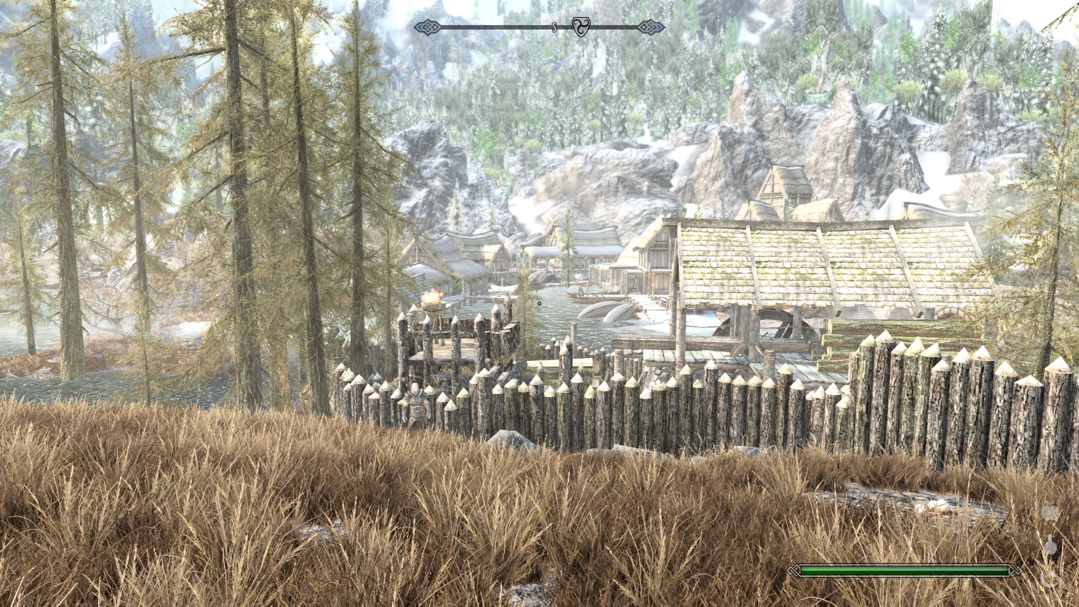
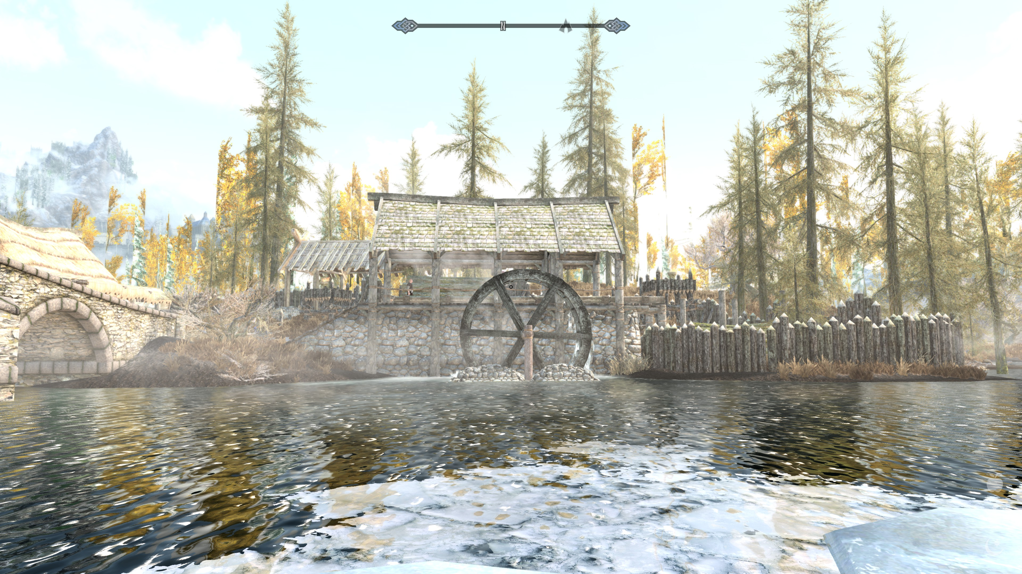
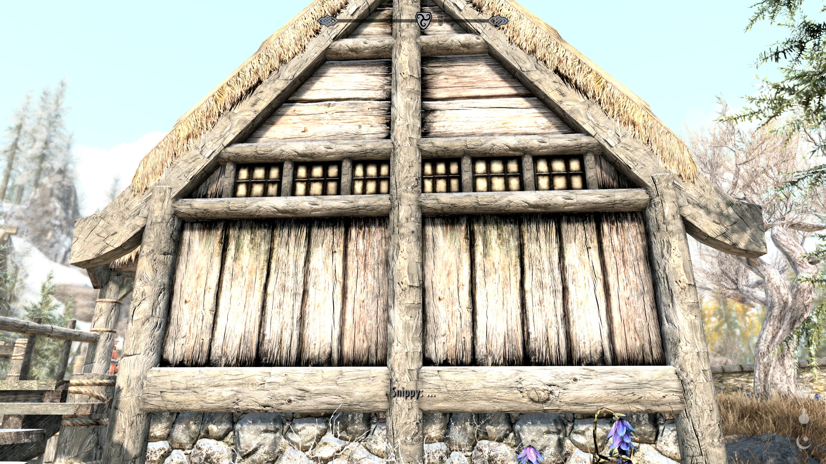
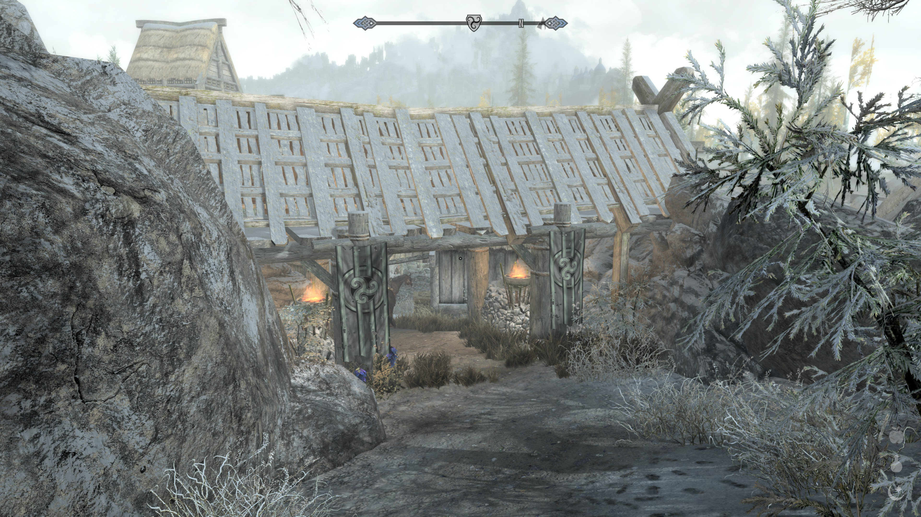
Research: Visual
Procedural Art Presentation
Notes:
Here you either show your research document and show us your approach, the methods you set out to use and other looks into interesting and suitable tools and techniques if applicable.
Use the rubrics from the manual as a basis for what you want us to see:
(use as many slides for this as you want or need)

Slide 6
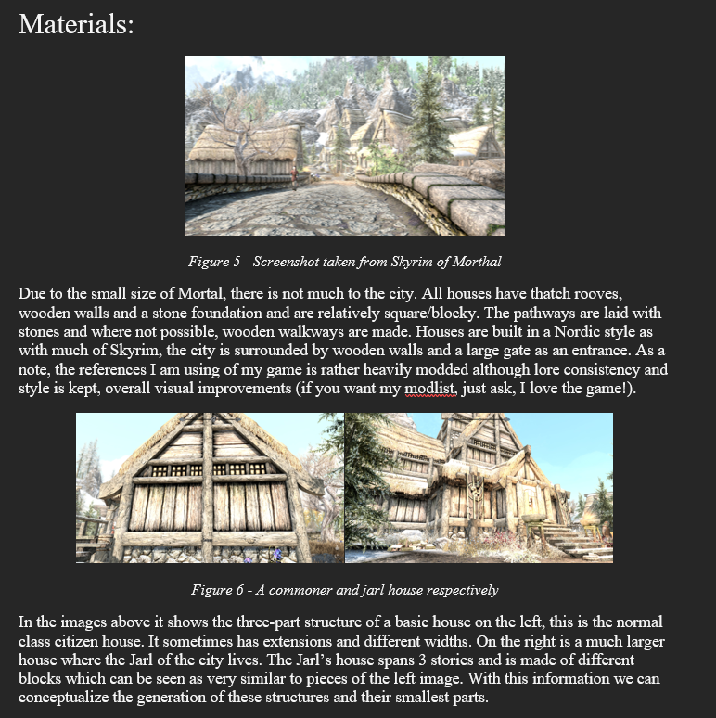
Research: Material
Procedural Art Presentation
Notes:
Here you either show your research document and show us your approach, the methods you set out to use and other looks into interesting and suitable tools and techniques if applicable.
Use the rubrics from the manual as a basis for what you want us to see:
(use as many slides for this as you want or need)

Slide 7
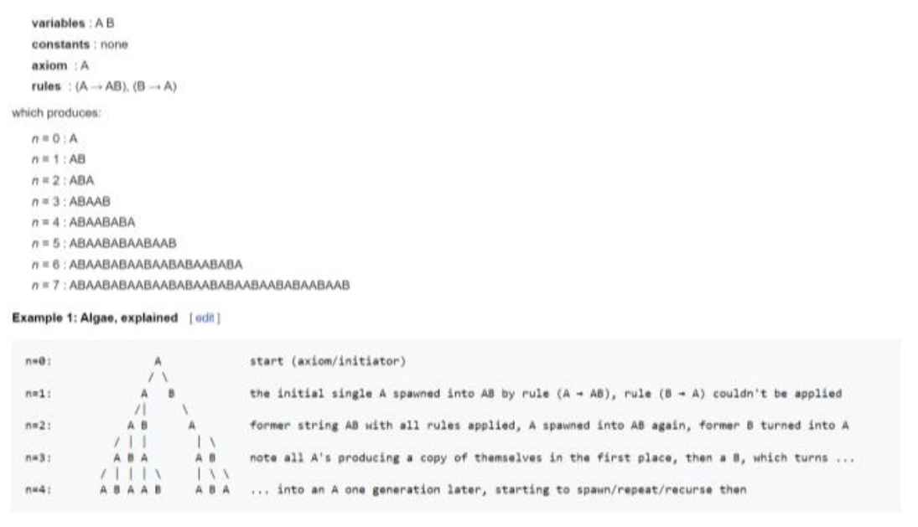
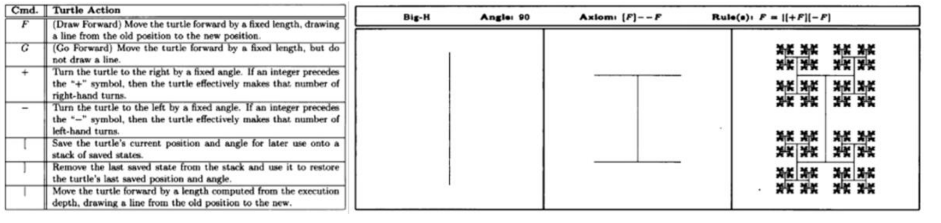
Research: Procedural Techniques
Procedural Art Presentation
Notes:
Here you either show your research document and show us your approach, the methods you set out to use and other looks into interesting and suitable tools and techniques if applicable.
Use the rubrics from the manual as a basis for what you want us to see:
(use as many slides for this as you want or need)

Slide 8
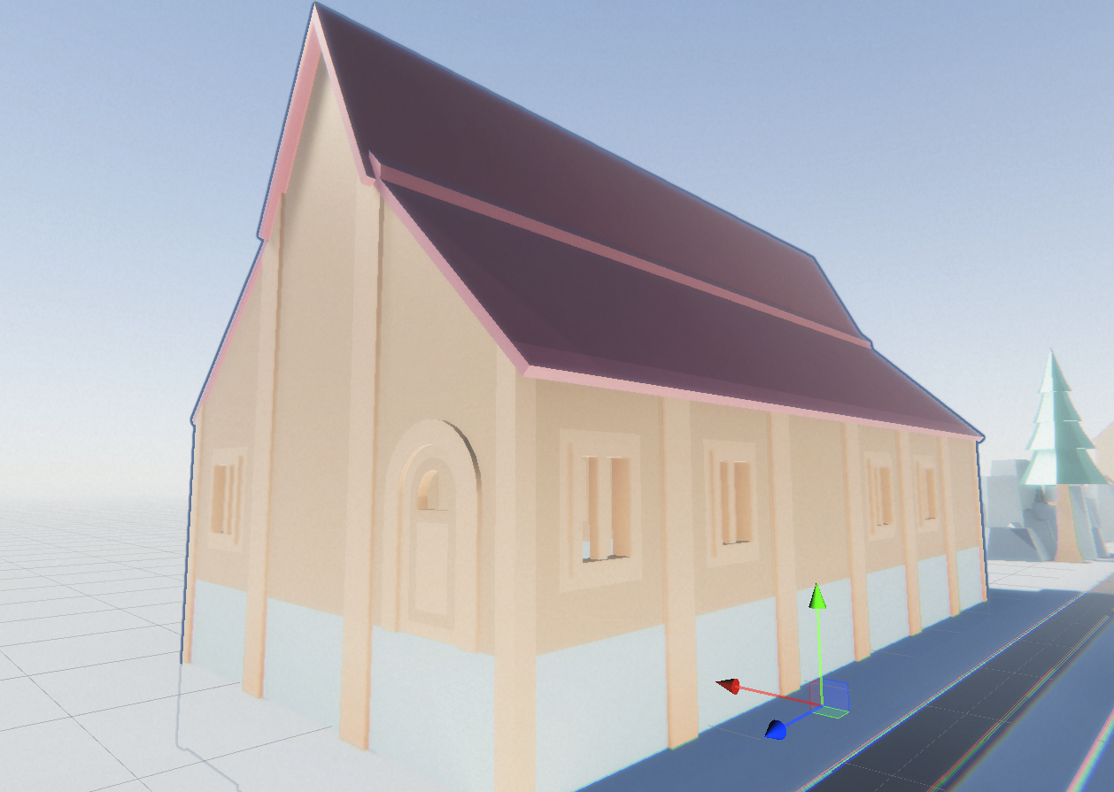
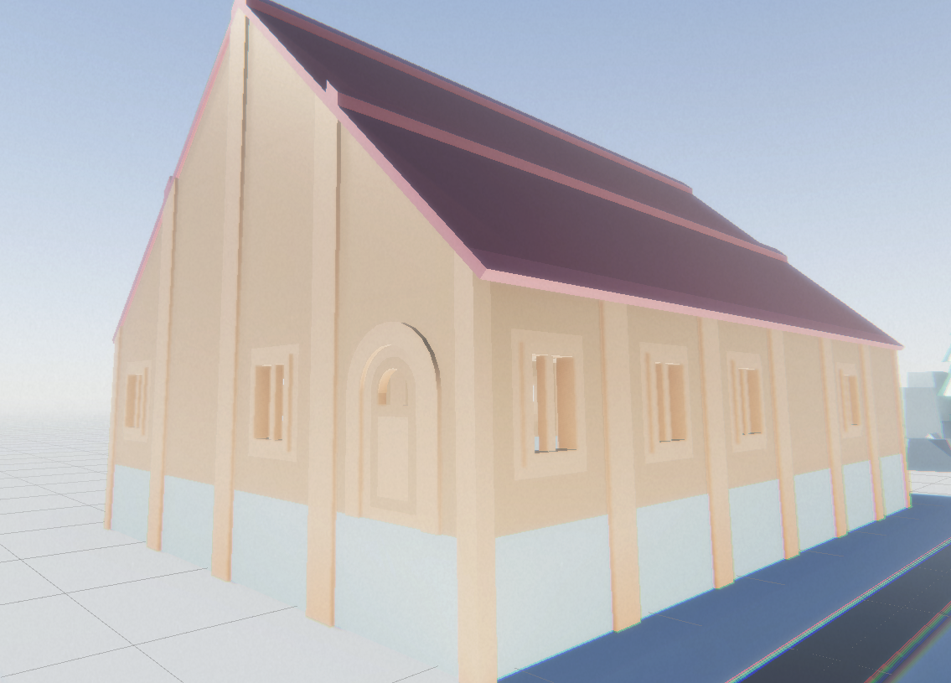
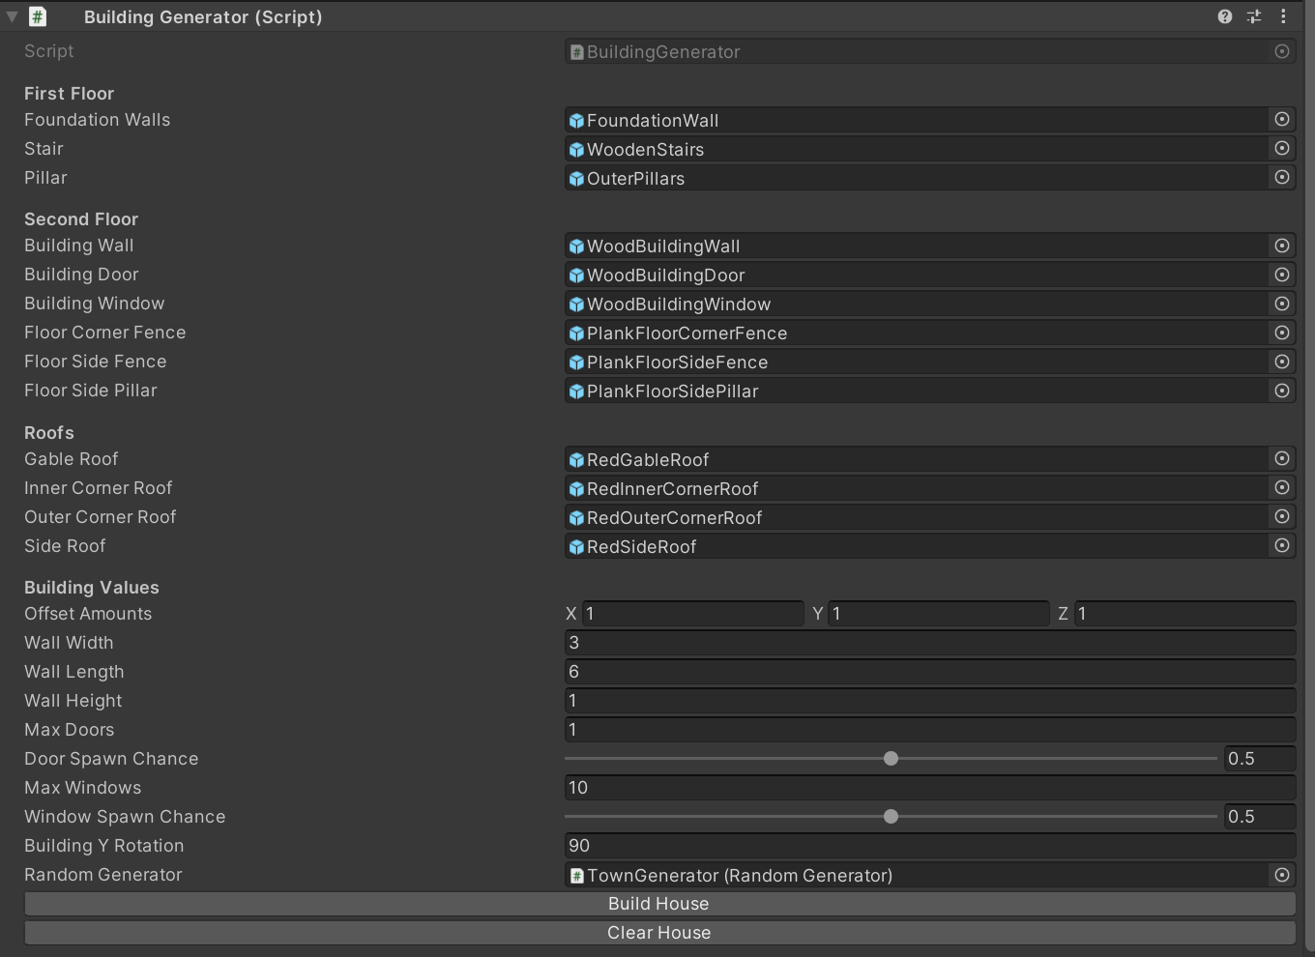
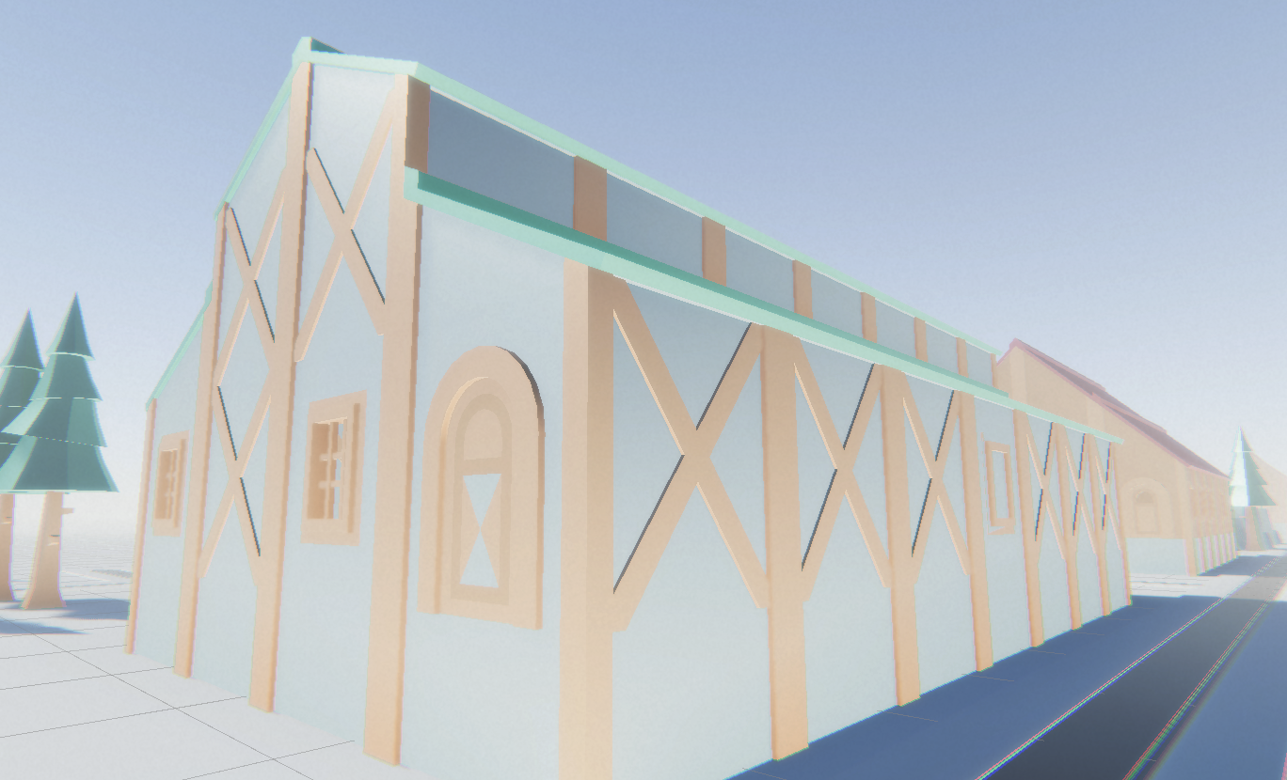
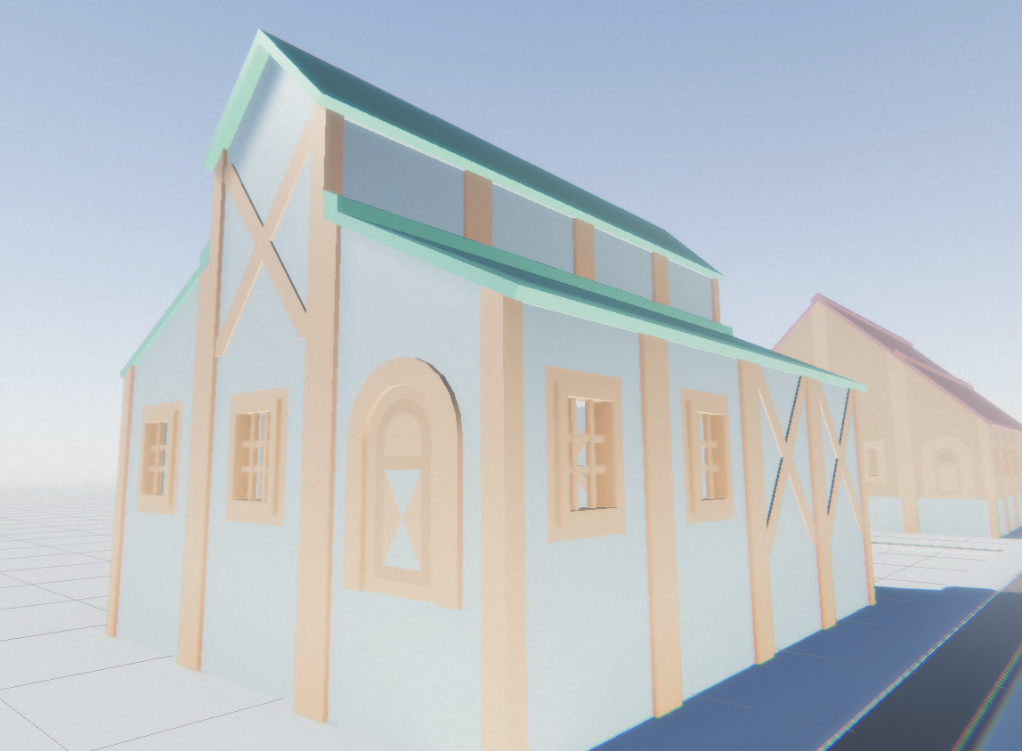
MESHES AND STRUCTURES
Procedural Art Presentation
Notes:
Here you show your approach to modular asset design and the generation of structures, either through code or even manual labour. Also show us the ways you did basic or advanced optimization.
Use the rubrics from the manual as a basis for what you want us to see:
(use as many slides for this as you want or need)

Slide 9
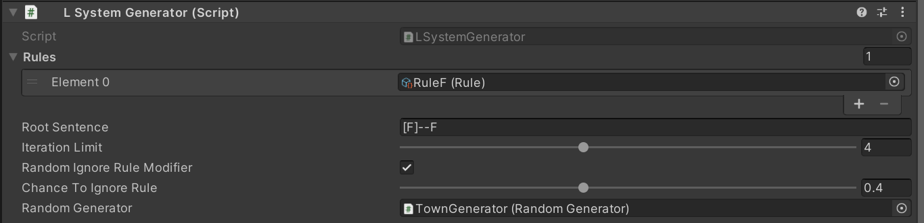
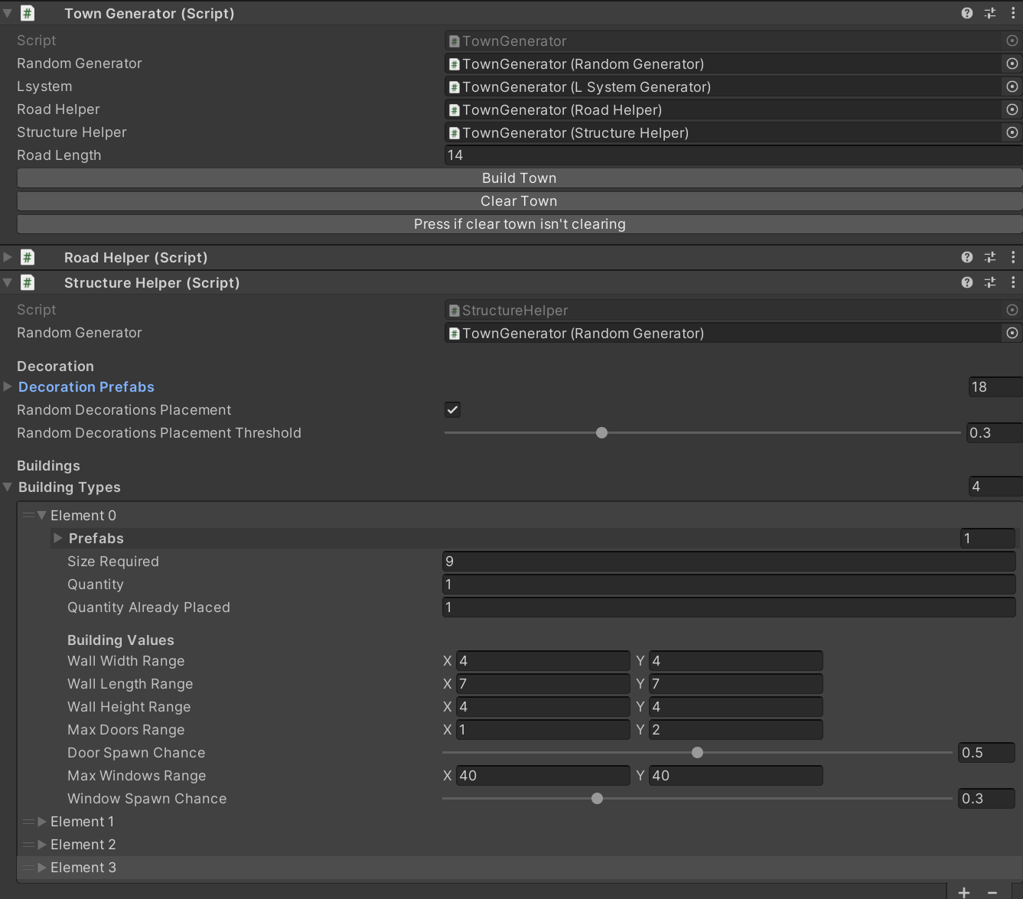
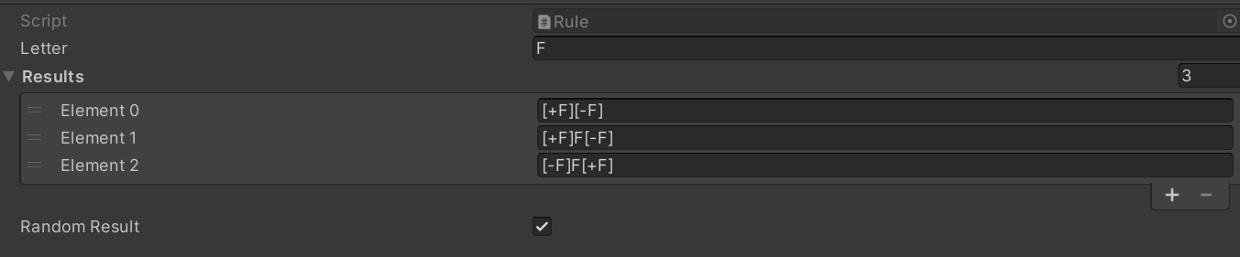
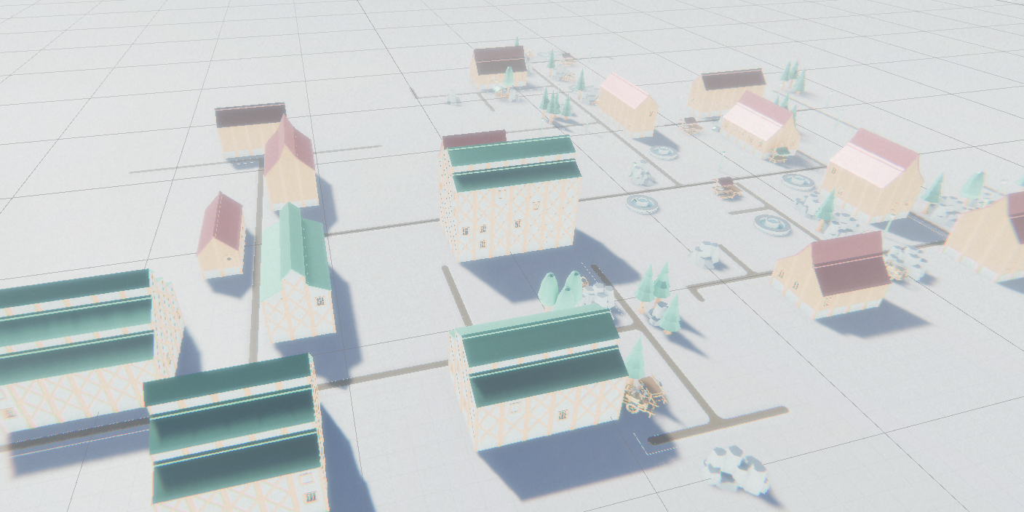
3. CUSTOMIZABILITY AND CONTROL
Procedural Art Presentation
Notes:
Here you show us custom Tooling in Unity if applicable as well as the amount of and ways to control your assets procedurally.

Slide 10
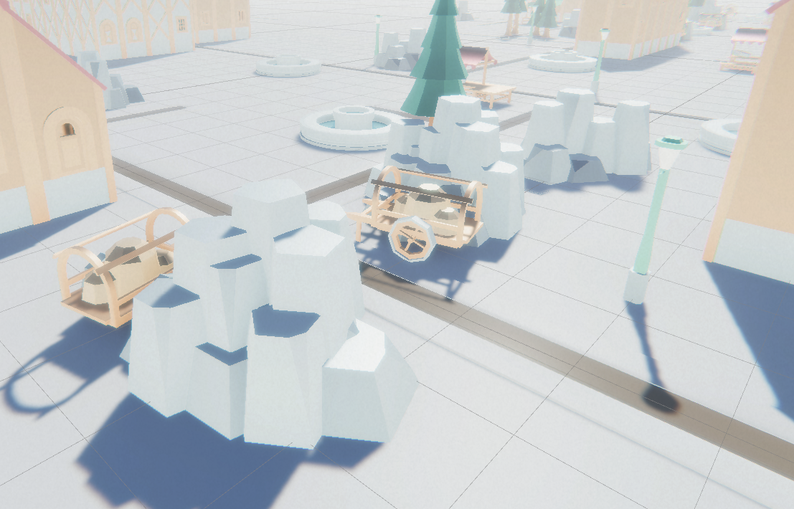
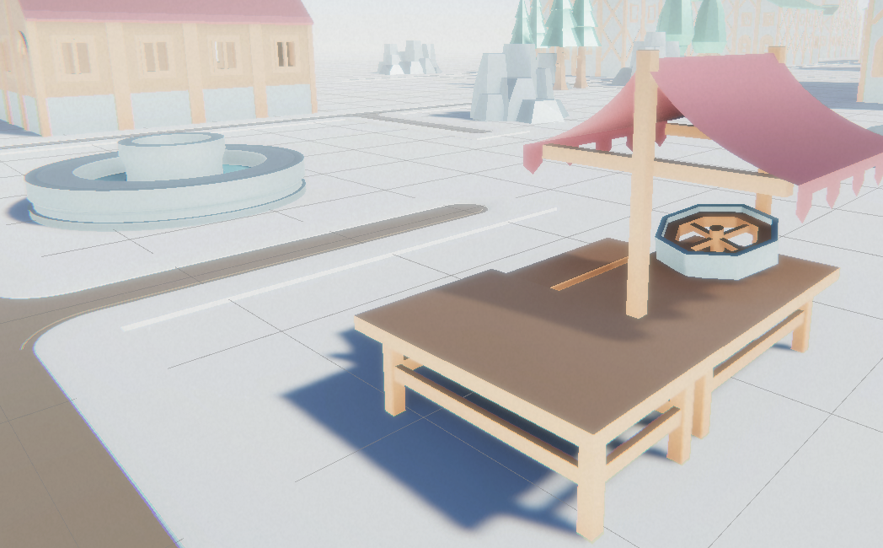
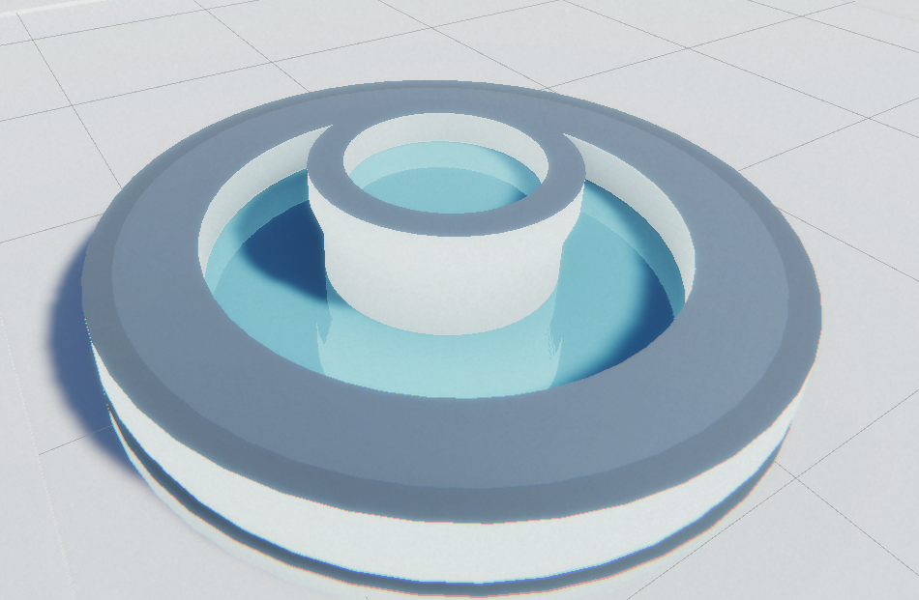
4. ON THE LOOK AND FEEL : Props
Procedural Art Presentation
Notes:
In the following slide(s) you showcase additional props for set dressing to make the city come to life.
In case you (ab)used (the HDRP’s) lighting and the Post-Processing stack to your advantage, please refer to the stack and show us how you maximized the visual fidelity that way.

Slide 11
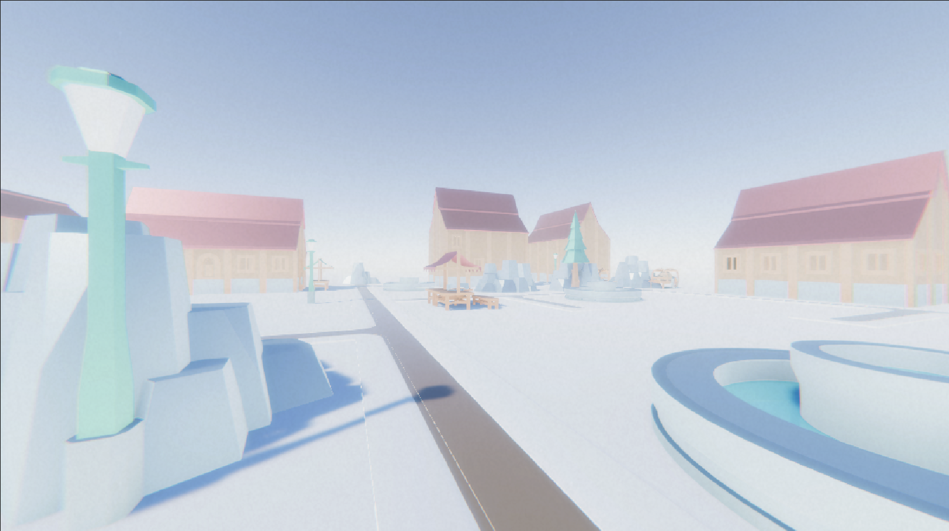
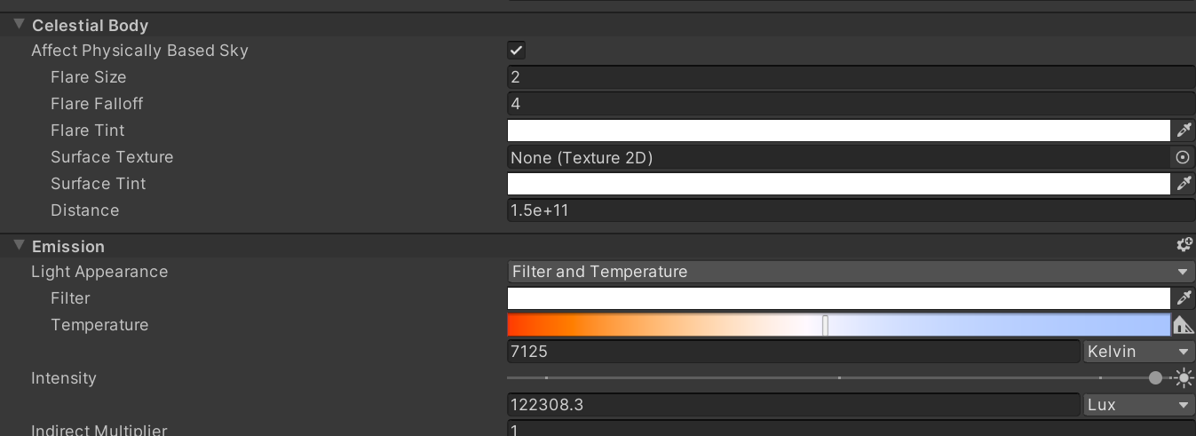
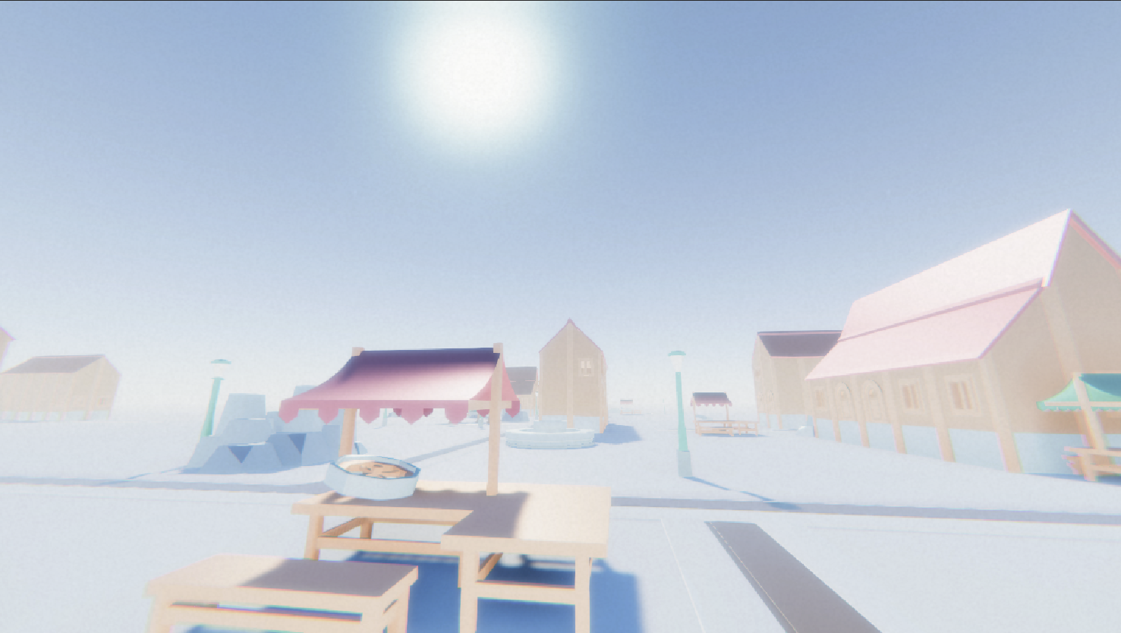
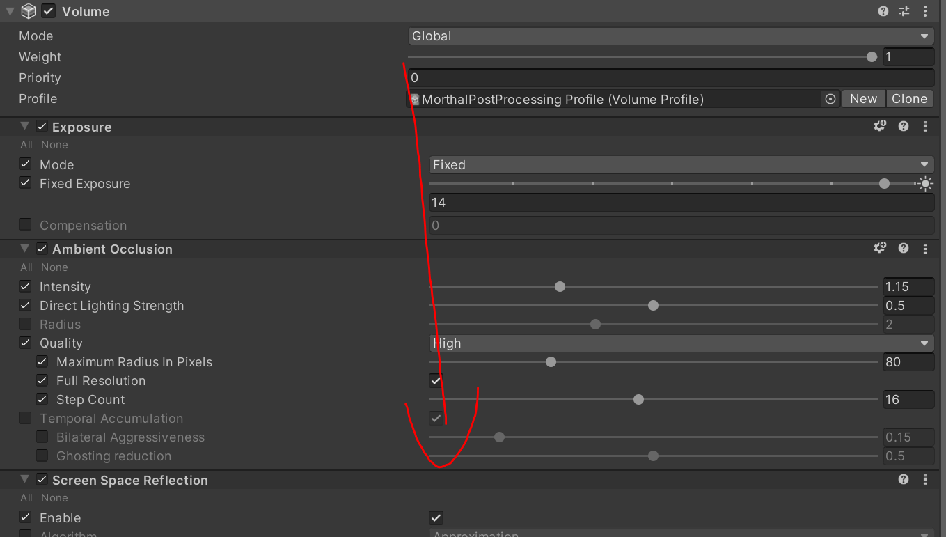
4. ON THE LOOK AND FEEL: Post Processing / Lighting
Procedural Art Presentation

Slide 12
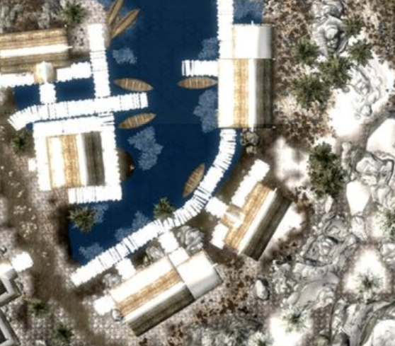
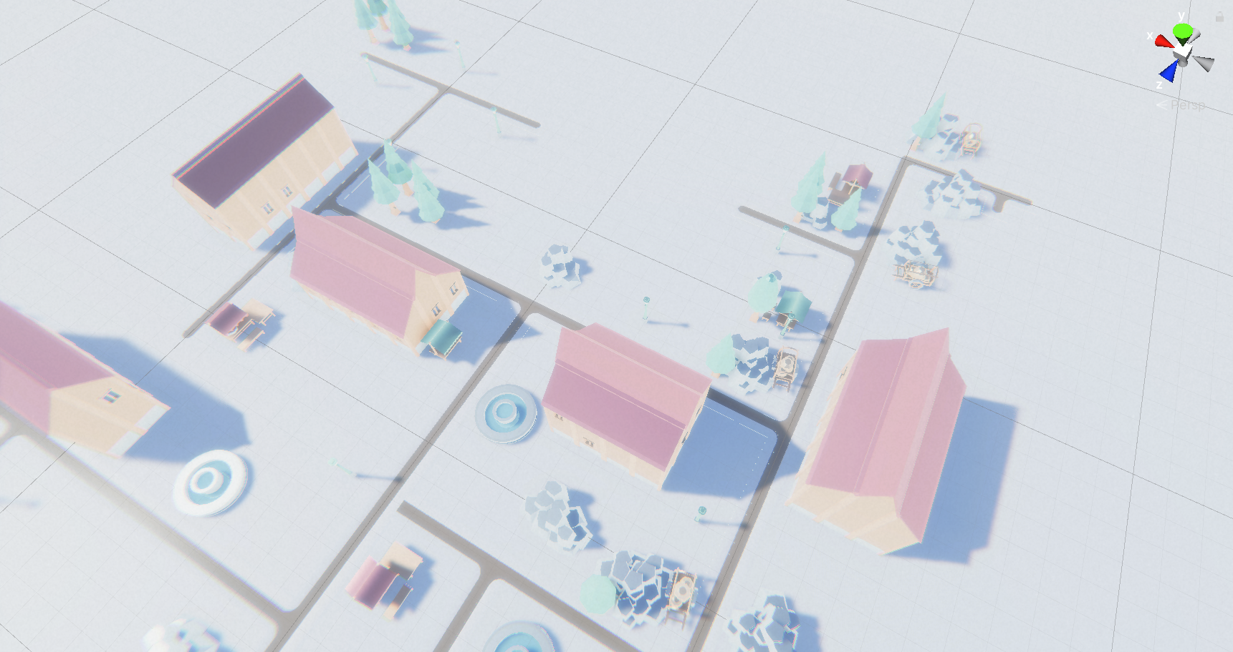
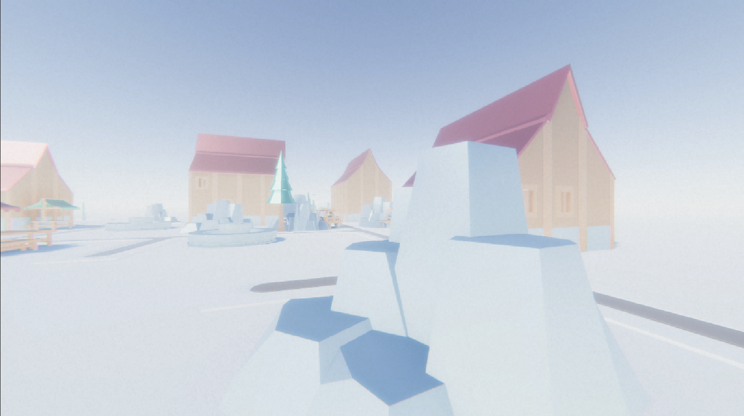
4. ON THE LOOK AND FEEL: Overall theme
Procedural Art Presentation

Slide 13
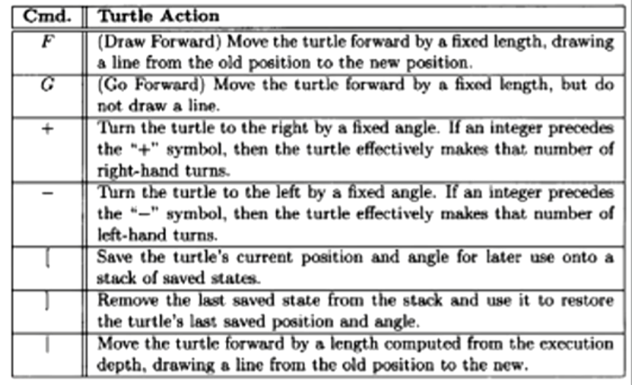
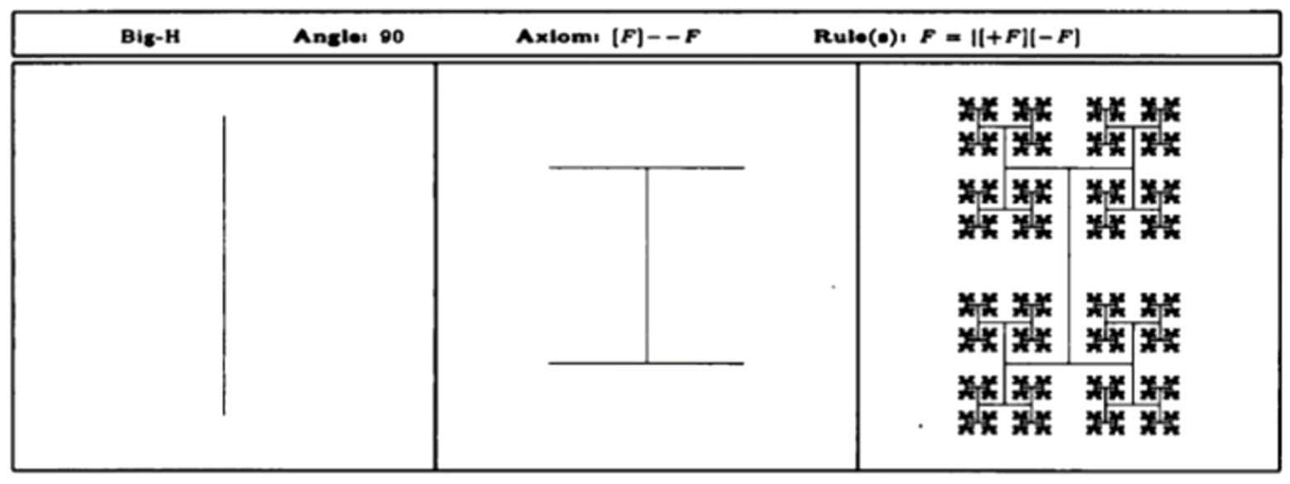
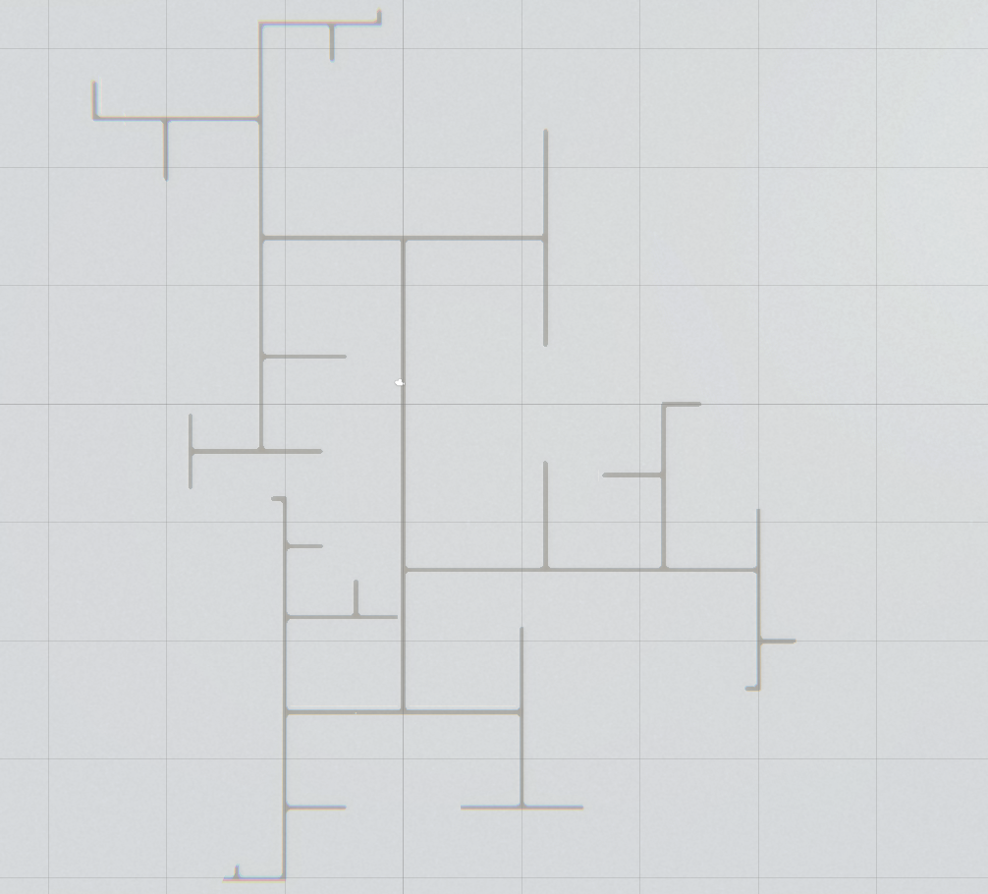
5. MY PROUDEST ACCOMPLISHMENT
Procedural Art Presentation

Slide 14
6. REFERENCE LIST
Procedural Art Presentation
[1] | IGN, “Morthal - The Elder Scrolls V: Skyrim Wiki Guide - IGN,” IGN, 23 November 2016. [Online]. Available: https://www.ign.com/wikis/the-elder-scrolls-5-skyrim/Morthal. [Accessed 7 April 2022].
[2] | Bethesda Softworks, “The Holds of Skyrim: A field officer's guide,” in The Skyrim Library : Volume 1 : The Histories, Washington, Titanbooks, 2015, p. 168.
[3] | The Unofficial Elder Scrolls Pages, “The Unofficial Elder Scrolls Pages,” 20 July 2020. [Online]. Available: https://en.uesp.net/wiki/Lore:Morthal. [Accessed 7 April 2022].
[4] | The Unofficial Elder Scrolls Pages, “File:ON-place-Morthal.jpg - The Unofficial Elder Scrolls Pagers (UESP),” 21 April 2020. [Online]. Available: https://en.uesp.net/wiki/File:ON-place-Morthal.jpg. [Accessed 7 April 2022].
[5] | The Unofficial Elder Scrolls Pages, “Online: Morthal - The Unofficial Elder Scrolls Pages(UESP),” 11 November 2021. [Online]. Available: https://en.uesp.net/wiki/Online:Morthal. [Accessed 7 April 2022].
[6] | The Unofficial Elder Scrolls Pages, “File:ON-place-Kjenstag Ruins.jpg - The Unofficial Elder Scrolls Pages(UESP),” 25 May 2021. [Online]. Available: https://en.uesp.net/wiki/File:ON-place-Kjenstag_Ruins.jpg. [Accessed 7 April 2022].
[7] | The Elder Scrolls Wiki, “Morthal(Skyrim) | Elder Scrolls | Fandom,” 18 July 2021. [Online]. Available: https://elderscrolls.fandom.com/wiki/Morthal_(Skyrim). [Accessed 4 April 2022].
[8] | UESP, “Skyrim:Radiant,” UESP, 16 July 2021. [Online]. Available: https://en.uesp.net/wiki/Skyrim:Radiant. [Accessed 14 June 2022].
[9] | Wikipedia, “L-system,” Wikipedia, 14 June 2022. [Online]. Available: https://en.wikipedia.org/wiki/L-system. [Accessed 14 June 2022].
[10] | G. W. Flake, “L-Systems and Fractal Growth,” in The Computational Beauty of Nature, N/A, The MIT Press, 1998, pp. 77-92.
[11] | S. V. Studio, “Procedural Town,” 23 February 2021. [Online]. Available: https://youtube.com/playlist?list=PLcRSafycjWFcbaI8Dzab9sTy5cAQzLHoy. [Accessed 14 06 2022].

Slide 15
You watched the presentation of
Ryan Stander 477316
Thank you for your attention.
Got any burning questions still?

